Slide 1
Module 8: Azure Features and Other APIs

Slide 2
Agenda
Azure APIs
IoT
Cognitive services
Bot Framework
Office APIs
Skype for Business
OneNote API

Slide 3
Internet of Things (IoT)

Slide 4
Real World IoT Use Cases
Street sweepers
Aircrafts
Auto
Cows
Electric charging stations
Fryers
Oil equipment
Vending machines
Dogs
Buses
Power plant
Internet of Things
Buildings
Factory floor
Racing
Trucks
Oil distribution
Elevators
Power tools
Vaccine dispensers
Mining equipment
Surveillance
Postboxes
Engines
Smart meters
Smart grids
Medical devices

Slide 5
Azure IoT Hub features
Telemetry
Send high throughput telemetry data
Device Twin (coming soon)
Synchronize configuration properties between Cloud and device
Methods (coming soon)
Imagine calling a method on a device from the Cloud… and vice-versa
Device Management (Public Preview)
Enroll, organize, maintain, decommission devices

Slide 6
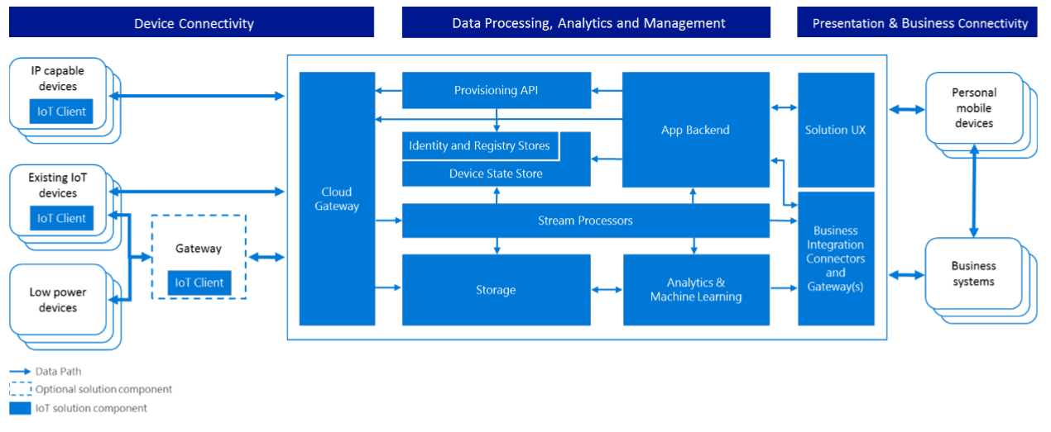
IoT Reference Architecture
https://azure.microsoft.com/en-us/updates/microsoft-azure-iot-reference-architecture-available/

Slide 7
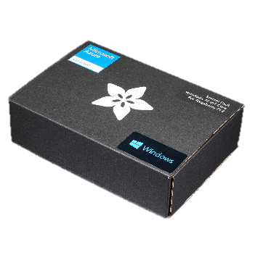

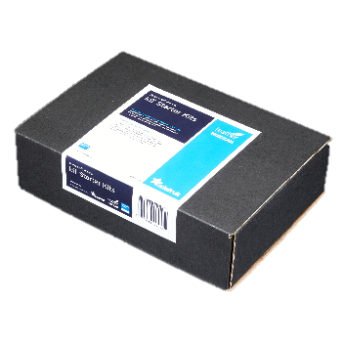
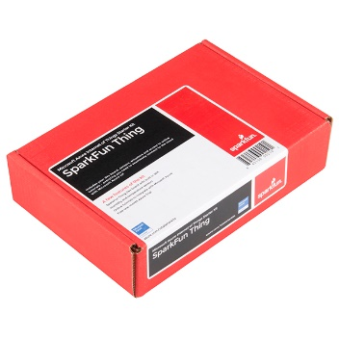
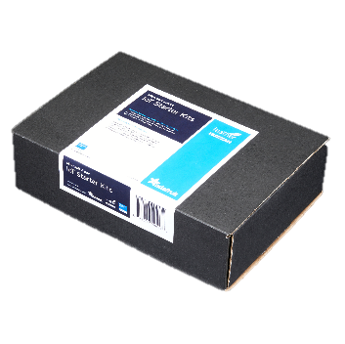
Azure IoT Starter Kits
Raspberry Pi 2 Kit
Windows 10 and Raspbian
Samples in C and C#
Intel Edison Kit
Linux Yocto
Samples in JavaScript (Node.js)
Feather M0 Wi-Fi Kit
RTOS
Samples in Arduino IDE and C
ThingDev Kit
RTOS
Samples in Arduino and C
Feather Huzzah ESP8266 Kit
RTOS
Samples in Arduino IDE and C
http://azure.com/iotstarterkits

Slide 8
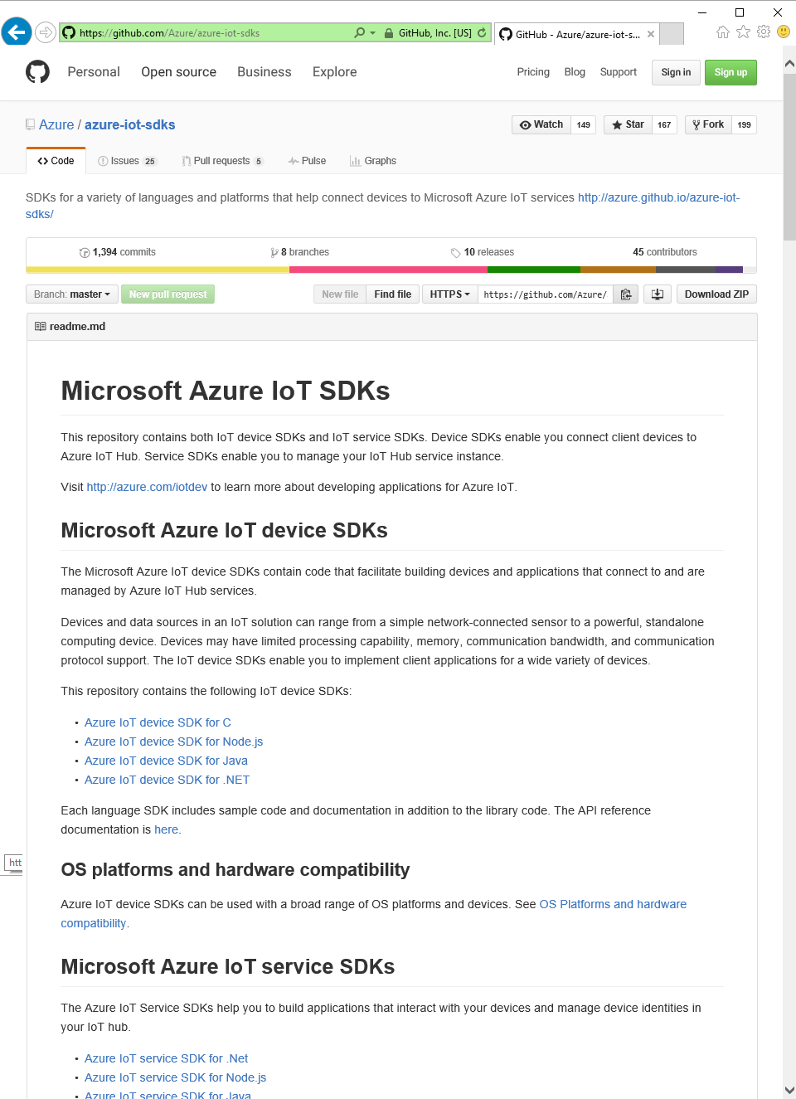
Azure IoT SDKs
Open Source
Everything is on GitHub, open source under MIT license
Cross-Platform Support
Microcontrollers (ARM Mbed, Arduino, ESP8622, TI CC3200,…)
RTOS, Linux (Ubuntu, Debian, Fedora, Raspbian), Windows 7/8/10, Android, iOS (with Xamarin)
Multi-Language Support
Service Client SDK – C#, Java, JavaScript, Python (on its way)
Device Client SDK – C, JavaScript, Java, C# (including PCL), Python
Xamarin Compatible
Includes Xamarin compatible libraries
Packages
NuGet, npm, maven, apt-get
Tools
X-plat CLI (iothub-explorer) and for Windows (Device-Explorer)
Easy To Get Started
Samples, walkthroughs to get you started quickly

Slide 9
Device & Service Client SDKs
Client | OS/Runtime | Version | Protocols | Packages
C device client | Debian Linux | 7.5 | HTTPS, AMQP, MQTT, AMQP over WebSockets | None
 | Fedora Linux | 20 | HTTPS, AMQP, MQTT, AMQP over WebSockets | None
 | mbed OS | 2 | HTTPS, AMQP, MQTT | https://developer.mbed.org/users/AzureIoTClient/
 | TI-RTOS | 2.x | HTTPS | None
 | Ubuntu Linux | 14.04 | HTTPS, AMQP, MQTT, AMQP over WebSockets | https://launchpad.net/~aziotsdklinux/+archive/ubuntu/ppa-azureiot
 | Windows desktop | 10 | HTTPS, AMQP, MQTT, AMQP over WebSockets | https://www.nuget.org/packages/Microsoft.Azure.IoTHub.IoTHubClient/
 | Yocto Linux | 2.1 | HTTPS, AMQP | None
 | Arduino (MKR1000, Zero, ESP8266, Feather M0) | IDE 1.6.8 | HTTPS | https://github.com/arduino-libraries/AzureIoTHub
Node.js Device client | Node.js | 0.10+ | HTTPS, AMQP, MQTT, AMQP over WebSockets | https://www.npmjs.com/package/azure-iot-device
Node.js Service client | Node.js | 0.10+ | N/A | https://www.npmjs.com/package/azure-iothub
Java Device client | Java SE (Windows) | 1.7 | HTTPS, AMQP, MQTT | http://mvnrepository.com/artifact/com.microsoft.azure.iothub-java-client/iothub-java-device-client
 | Java SE (Linux) | 1.7 | HTTPS, AMQP, MQTT | http://mvnrepository.com/artifact/com.microsoft.azure.iothub-java-client/iothub-java-device-client
 | Android | API 15 | HTTPS, MQTT
Java Service client | Java SE | 1.8 | N/A | http://mvnrepository.com/artifact/com.microsoft.azure.iothub-java-client/iothub-java-service-client
C# Device client | .Net | 4.5 | HTTPS, AMQP, MQTT, AMQP over WebSockets | https://www.nuget.org/packages/Microsoft.Azure.Devices.Client/
 | UWP | 10 | HTTPS, AMQP | https://www.nuget.org/packages/Microsoft.Azure.Devices.Client/
 | PCL (Xamarin, Mono, UWP, WP8.1, Win8.1) |  | HTTPS, AMQP, MQTT, AMQP over WebSockets | https://www.nuget.org/packages/Microsoft.Azure.Devices.Client.PCL/
C# Service client | .Net | 4.5 | N/A | https://www.nuget.org/packages/Microsoft.Azure.Devices/
Python Device client | Python | 2.7.x, 3.4.x, 3.5.x | HTTPS, AMQP, MQTT | none

Slide 10
Resources
Azure IoT Client SDKs: github.com/azure/azure-iot-sdks
Get started with Azure IoT Hub device management: azure.microsoft.com/en-us/documentation/articles/iot-hub-device-management-get-started/
Azure IoT Gateway SDK repo: github.com/Azure/azure-iot-gateway-sdk
Microsoft Azure IoT reference architecture: azure.microsoft.com/en-us/updates/microsoft-azure-iot-reference-architecture-available/
Azure IoT Partner Portal: aka.ms/AzureIoTPartner
Certified for Azure IoT: www.azure.com/certifiedforiot
Azure IoT User Voice forum: feedback.azure.com/forums/321918-azure-iot
IoT Advisors on Yammer: www.yammer.com/azureadvisors/#/threads/inGroup?type=in_group&feedId=5495841

Slide 11
Cognitive

Slide 12

Microsoft Cognitive Services Give your apps a human side
Vision
From faces to feelings, allow your apps to understand images and video
Speech
Hear and speak to your users by filtering noise, identifying speakers, and understanding intent
Language
Process text and learn how to recognize what users want
Knowledge
Tap into rich knowledge amassed from the web, academia, or your own data
Search
Access billions of web pages, images, videos, and news with the power of Bing APIs

Slide 13
Vision
Computer Vision API
Video API
Face API
Emotion API
Distill actionable information from images
Detect, identify, analyze, organize, and tag faces in photos
Personalize experiences with emotion recognition
Analyze, edit, and process videos within your app

Slide 14
Speech
Bing Speech API
Speaker Recognition API
Custom Recognition Intelligent Service
Convert speech to text and back again, and understand its intent
Give your app the ability to know who's talking
Fine-tune speech recognition for anyone, anywhere

Slide 15




Language
Bing Spell Check API
Web Language Model API
Linguistic Analysis API
Language Understanding Intelligent Service (LUIS)
Text Analytics API
Detect and correct spelling mistakes within your app
Leverage the power of language models trained on web-scale data
Easily parse complex text with language analysis
Teach your apps to understand commands from your users
Detect sentiment, key phrases, topics, and language from your text

Slide 16

Knowledge
Academic Knowledge API
Knowledge Exploration Service
Entity Linking Service
Recommendations API
Explore relationships among academic papers, journals, and authors
Add interactive search over structured data to your project
Contextually extend knowledge of people, locations, and events
Provide personalized product recommendations for your customers

Slide 17
Search
Bing Web Search API
Bing Autosuggest API
Bing Image Search API
Bing Video Search API
Bing News Search API
Connect powerful search to your apps
Give your app intelligent autosuggest options for searches
Bring advanced image and metadata search to your app
Trending videos, detailed metadata, and rich results
Link your users to robust and timely news searches

Slide 18
How do I use it?

Slide 19
Links

Slide 20
Bot Framework

Slide 21

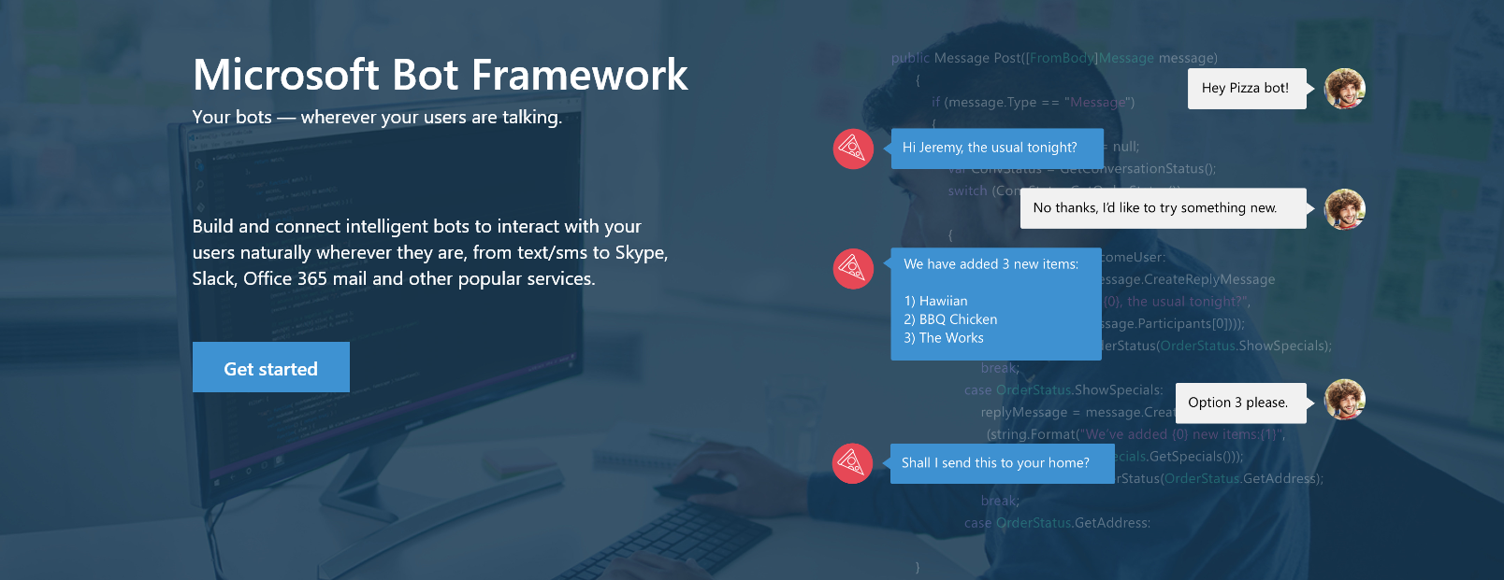

www.botframework.com

Slide 22
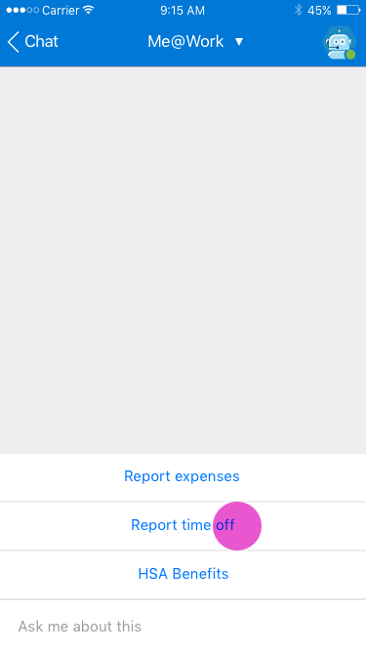
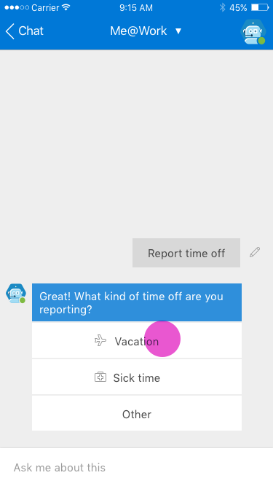
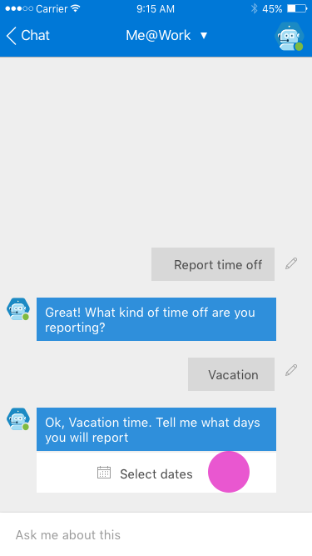
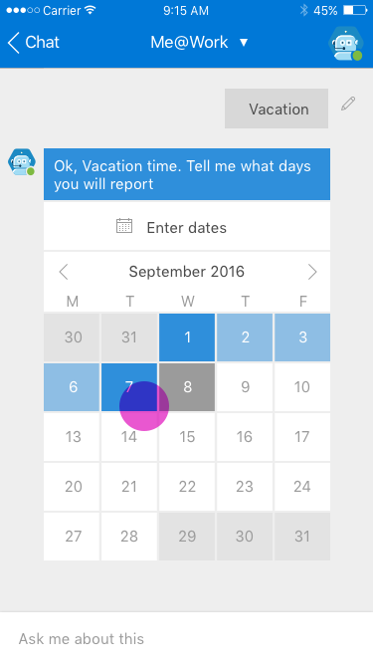
My Org Bot – Vacation Reporting

Slide 23

Bot Framework Components
Your Bot Framework Bot
Developer Portal
Bot Builder SDKs
Bot Directory
Connect your bot(s) to text/sms, Office 365 mail, Skype, Slack, and other services.
Build great dialogs within your Node.js- or C#-based bot
COMING SOON - Try, use, and add published bots to the world’s top conversation experiences
Register, connect, publish and manage your bot through the bot dashboard
Automatic card normalization across channels
Skype channel auto-configured
Embeddable web chat control
Host your bot in your app using DirectLine API
Fast, secure message routing
Diagnostic tools
Open source SDK on Github
From simple built-in prompts and command dialogs to simple to use yet sophisticated ‘FormFlow’ dialogs
Support for rich attachments (image, card, video, doc etc); support for calling Skyoe
Online/offline emulator
Add smarts with Cognitive Services
Public directory of bots registered and approved with Bot Framework
Users can try your bot from the directory via the web chat control
Users can discover and add your bot to the channels on which it is configured

Slide 24
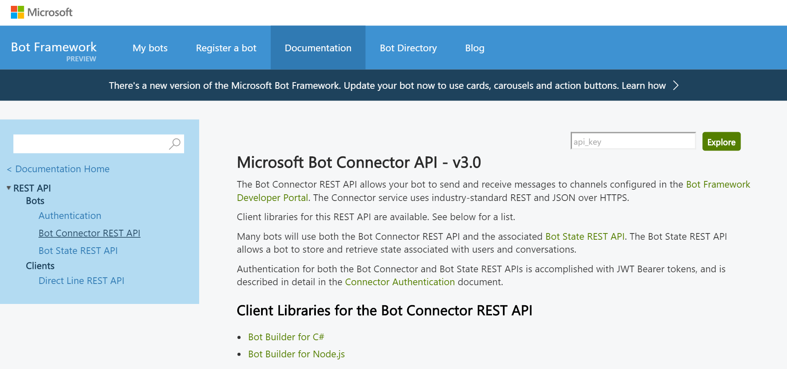
Bot Builder SDK
.NET framework with C# or Node.js
REST and REST State APIs
Manages the conversation state
Bot
Logic
Bot Builder SDK
Web
Service
LUIS

Slide 25
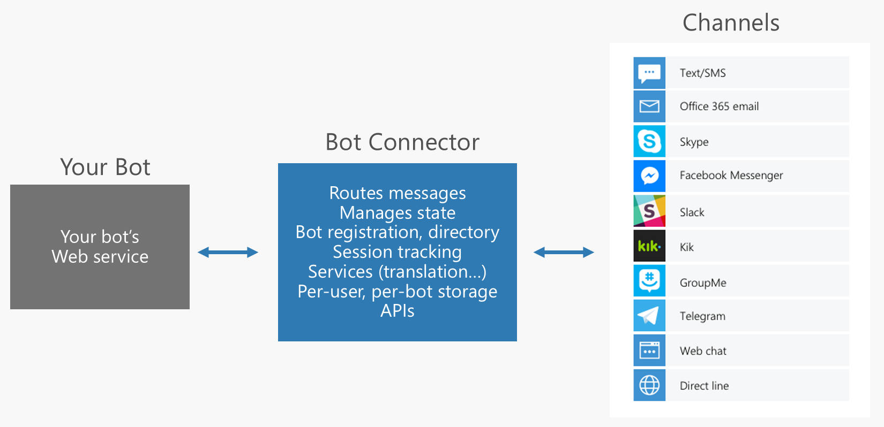
Supported Channels

Slide 26
Getting Started with Azure Bot www.botframework.com github.com/Microsoft/BotBuilder

Slide 27
Office APIs

Slide 28
Skype for Business

Slide 29
What is it?

Slide 30
How do I use it?

Slide 31
References
https://msdn.microsoft.com/en-us/skype/websdk/skypewebsdk
https://msdn.microsoft.com/en-us/skype/appsdk/skypeappsdk
http://developer.skype.com
A Technical Deep Dive into Building Web Apps with the Skype Web SDK (Ignite 2015)
Engage and Win Users with Your Apps Through Intelligent Conversations (Build 2016)
Relation Sessions
Drive real-world success with Skype for Business platform solutions https://myignite.microsoft.com/sessions/2631
Dive deep on the new Trusted Application API for Skype for Business Online https://myignite.microsoft.com/sessions/2629
Build native cloud apps for Skype for Business: Skype Developer platform overview
https://myignite.microsoft.com/sessions/2630

Slide 32
OneNote API

Slide 33
What is it?

Slide 34
How do I use it?

Slide 35
Links

